Slide 1
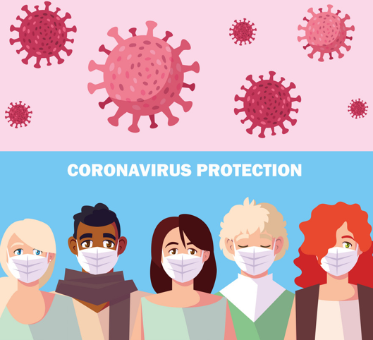

Wearing a Face Mask
Created by John McNally, Student Speech and Language Therapist, under the supervision of Michelle O’Donoghue, SLT, CORU reg 018688

Slide 2
How to use a social story™
Social stories™ are short, simple stories that help people to understand what is going on (Gray 2010).
During this pandemic, there has been a lot of change. Social stories are very helpful to understand some of these changes.
Follow these steps when using this social story:
Read this story before you leave your house to go outside.
When possible read this story in a quiet and calm environment.
Review the story as often as required - some social stories will be reviewed once a day, others just before the situation for which they were written.
As you get used to the new situation and the story no longer seems necessary, you can phase out the story. For example, you can read it only when you are having difficulty understanding ‘why you should wear a face mask’ to refresh your memory.
We hope that you enjoy using this social story.
Reference: Gray, C. (2010) The New Social Story™ Book, Future Horizons: Texas

Slide 3
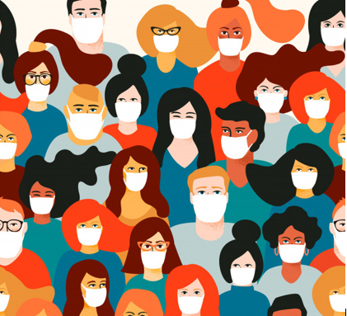
This is a story about why we all need to wear face masks to protect us from the coronavirus…

Slide 4

What is a face mask?

Slide 5
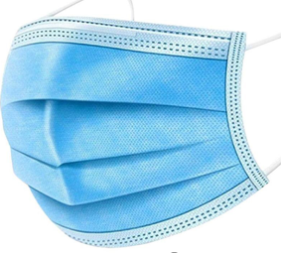
A face mask is made of fabric and it looks like this

Slide 6
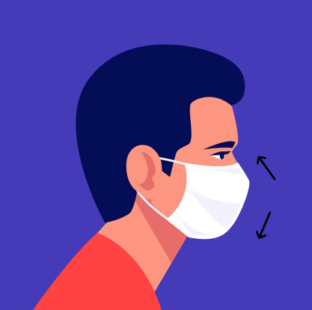
A face mask is something you wear over your mouth and your nose while you are outside your house

Slide 7
Why do I need to wear a face mask?

Slide 8
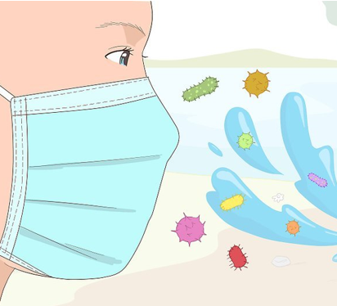

We use a face mask to stop us from breathing in the coronavirus and getting sick

Slide 9
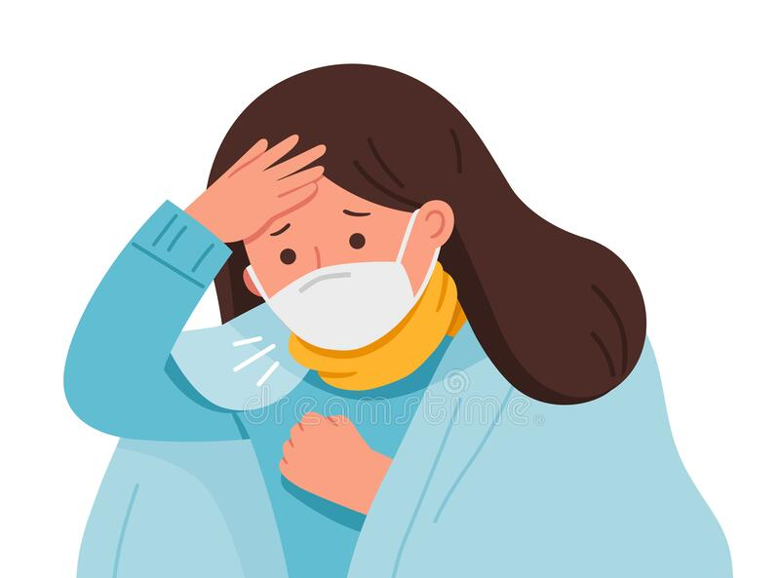
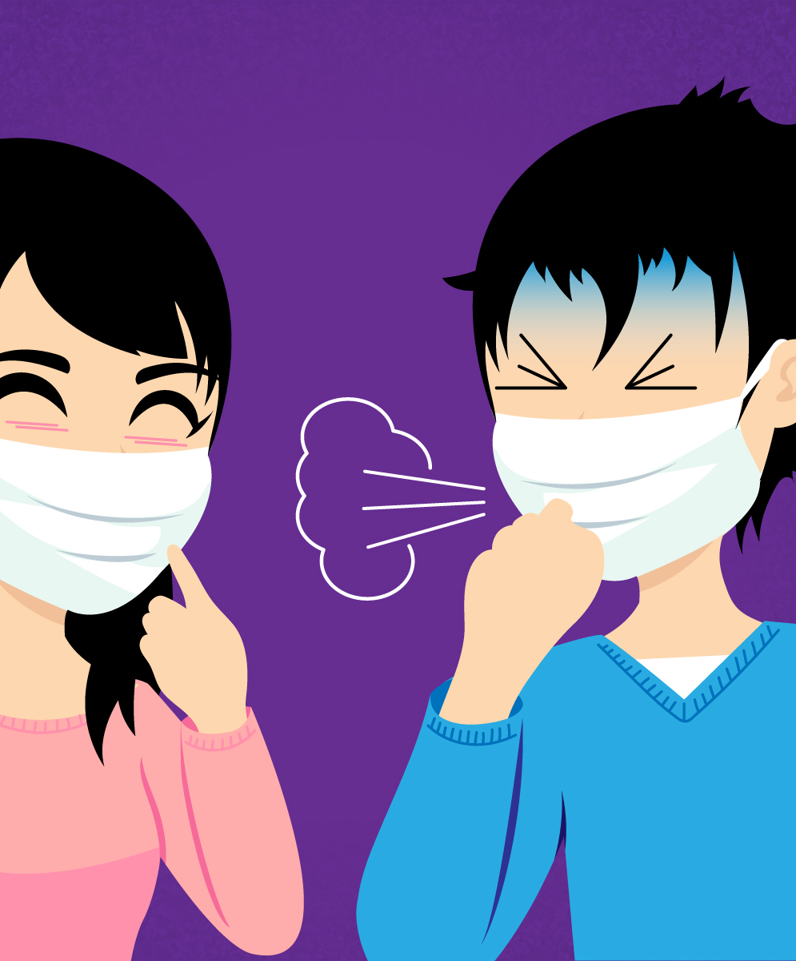
If we are sick, a face mask stops us from giving the coronavirus to other people when we cough or sneeze

Slide 10
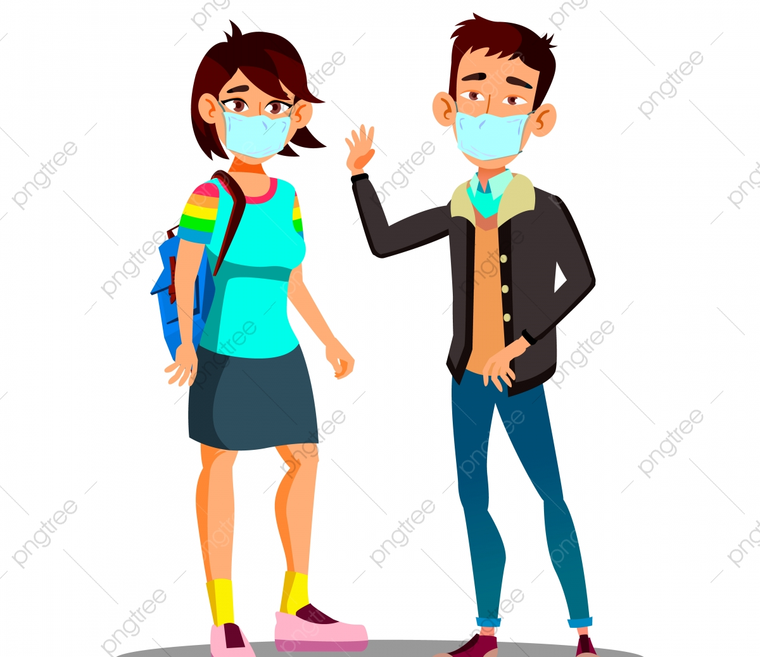

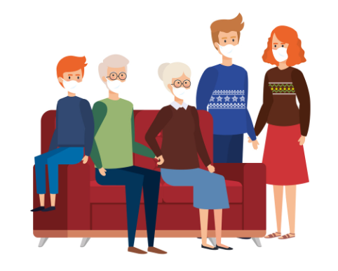
Face masks protect
Me
My family
My friends
My doctor
My carers

Slide 11
When should I wear a face mask?

Slide 12
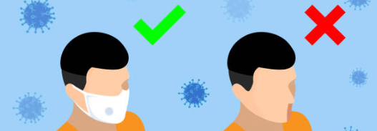
You should wear your face mask any time you go outside your house

Slide 13

You should wear your face mask when you are in the park

Slide 14

You should wear your face mask when you go shopping

Slide 15
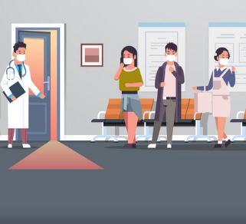
You should wear your face mask when you are at the clinic

Slide 16

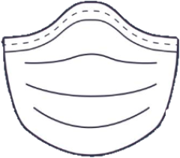
You should wear your face mask when you are at the pharmacy

Slide 17
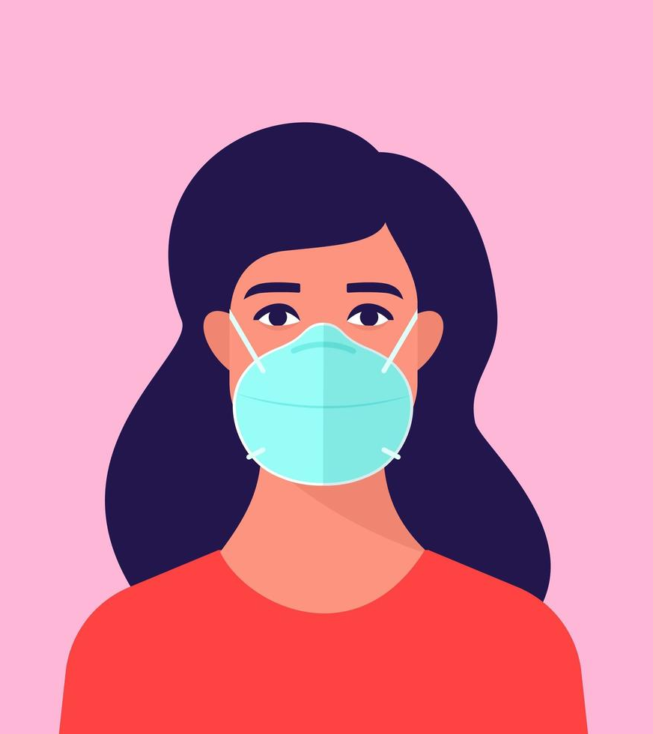
Even though your face mask might be uncomfortable it is important to keep it on when you are outside your house

Slide 18
How do I wear a face mask?

Slide 19
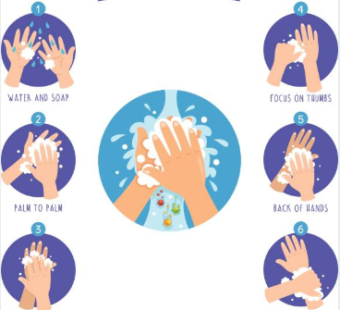
First, clean your hands with soap…

Slide 20
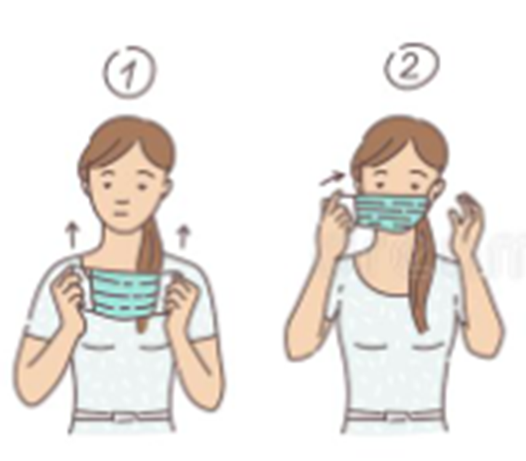
Hold the mask by the ear loops and place them around your ears and the mask over your face

Slide 21
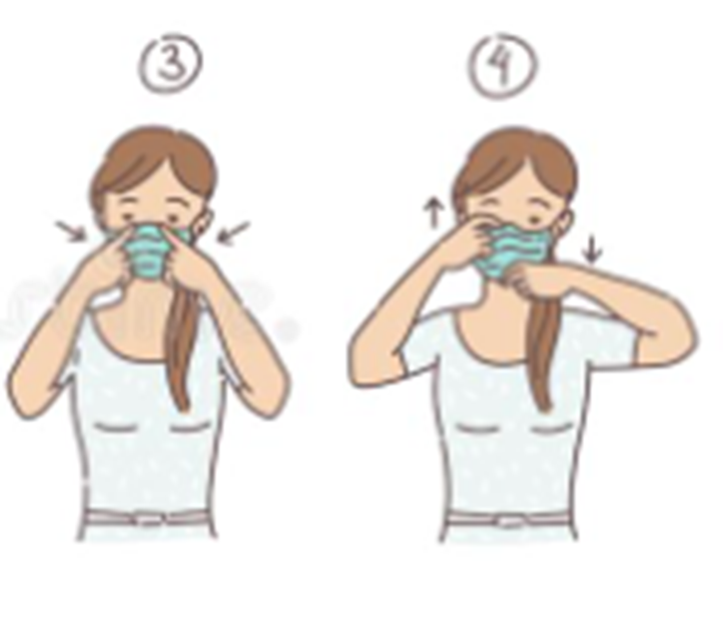
Push the mask tight against your nose and make sure it covers your mouth and nose completely

Slide 22
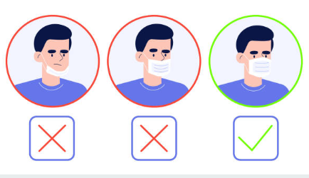

It should cover your face like this…

Slide 23
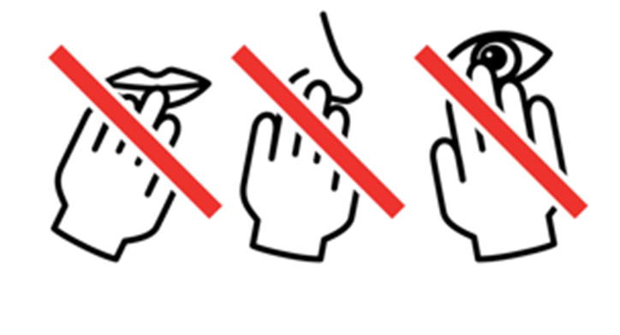
Don’t touch your face when you are wearing your mask

Slide 24

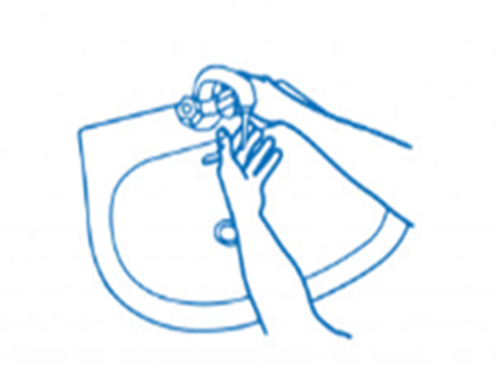
When you are finished with your mask and you are at home, throw it in the bin and wash your hands immediately

Slide 25

If you have a reusable mask then you can wash it and use it again.

Slide 26
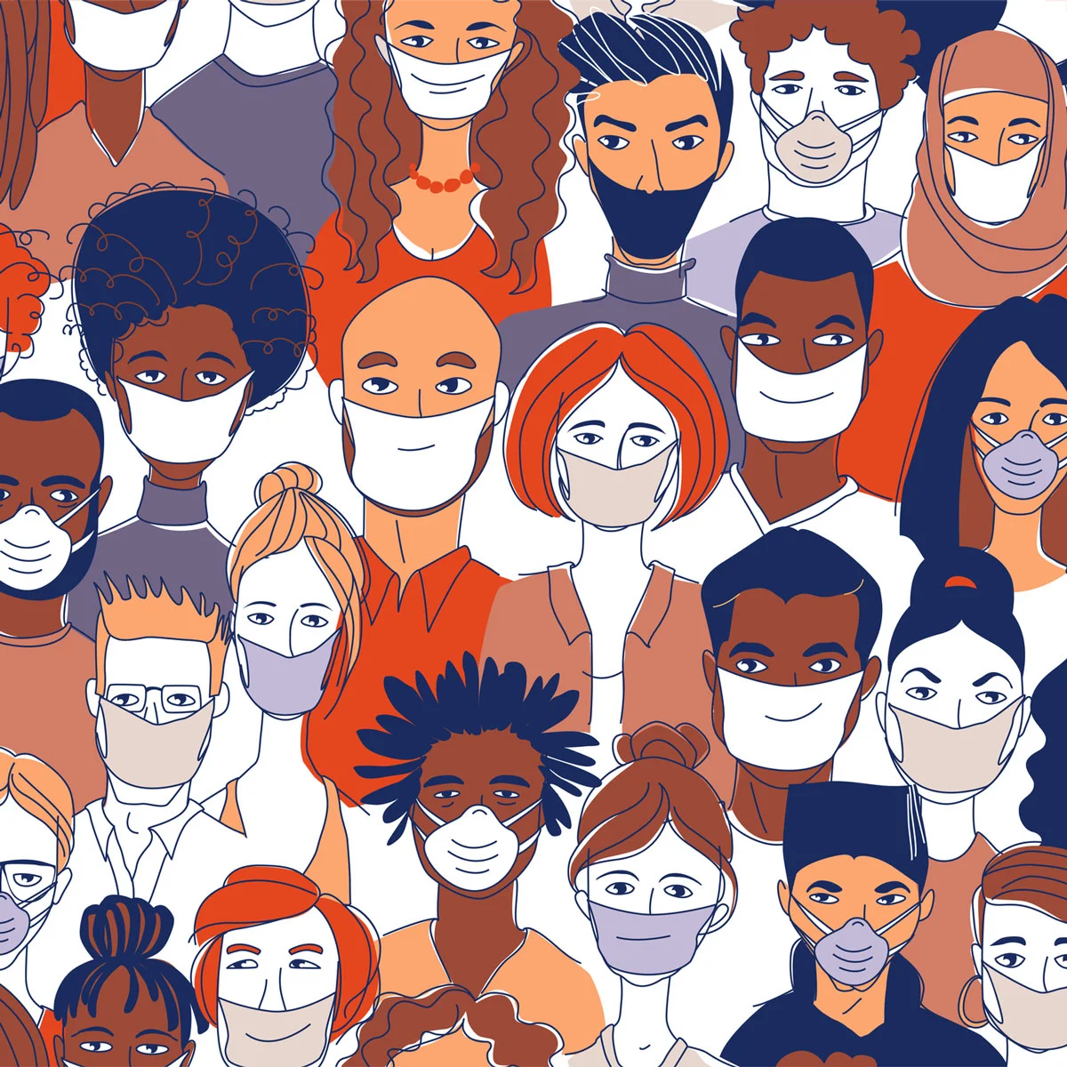


Wearing your face mask helps to protect you and the people around you

Slide 27
References
Image page 1: www.vectorstock.com/30150720
Image page 2: https://www.dreamstime.com/coronavirus-pandemic-ncov-vector-seamless-pattern-people-white-medical-face-mask-coronavirus-pandemic-ncov-vector-seamless-image175521504
Image page 3, 6, 11, 18: https://international-adviser.com/wp-content/uploads/sites/3/2020/03/Four-question-marks-blue-background.jpg
Image page 4: https://www.go4worldbusiness.com/member/view/2852672/wit-xiantao-tongda-non-woven-products-co-ltd-.html
Image page 5: https://www.vecteezy.com/vector-art/952526-man-wearing-disposable-medical-face-mask
Image page 7: https://www.bigstockphoto.com/es/image-362022973/stock-vector-crowd-of-infected-and-healthy-people-outside-during-corona-virus-outbreak-men-and-women-protecting
Image page 8: http://tyttrungchanh.medinet.gov.vn/chuyen-muc/deo-khau-trang-dung-cach-cmobile9480-25130.aspx
Image page 9: https://www.dreamstime.com/stock-illustration-mers-cov-protection-infographic-illustration-image55701731
Image page 10: a: https://pngtree.com/freepng/asian-teen-girl-boy-wearing-a-face-mask-in-the-city-coughing-vector-isolated-cartoon-illustration_5163323.html b: https://es.123rf.com/imagenes-de-archivo/pentagrama.html?alttext=1&orderby=2&sti=m0mlbi63d6sqsqv4to| c: https://www.vectorstock.com/royalty-free-vectors/grandmother-ill-medicine-vectors
Image page 12: https://www.istockphoto.com/ie/vector/stop-the-infection-you-need-to-wear-a-medical-mask-a-man-in-a-medical-mask-and-gm1208444346-349303341
Image page 13: https://es.123rf.com/clipart-vector/cartoon_park_playground.html?alttext=1&orderby=2&sti=o3bkp7k8wxvdg0071t|&mediapopup=144983790
Image page 14: https://www.alamy.com/Image ID: 2BER49Y
Image page 15: https://www.vectorstock.com/royalty-free-vector/asian-patients-in-masks-visiting-doctor-vector-29661504
Image page 16: https://www.change.org/p/drugs-controller-department-pharmacy-for-pharmacists-only-allow-registered-pharmacist-to-dispense-medicines/c/756206277
Image page 17: https://www.vecteezy.com/vector-art/952547-woman-wearing-medical-face-mask
Image page 19: https://www.istockphoto.com/ie/vector/vector-illustration-of-washing-hands-gm988830140-268098633
Image page 20/21: www.google.com/images
Image page 22: https://twitter.com/UnivHealthSys/status/1248362577433894912
Image page 23: https://www.dreamstime.com/set-do-not-touch-your-face-icon-simple-black-white-drawing-hand-touching-mouth-nose-eye-crossed-red-line-can-be-set-image176825549
Image page 24: a: www.google.com/images b: www.google.com/images
Image page 25: https://www.istockphoto.com/ie/illustrations/quarantine-drawing?mediatype=illustration&phrase=quarantine%20drawing&sort=mostpopular

