Slide 1
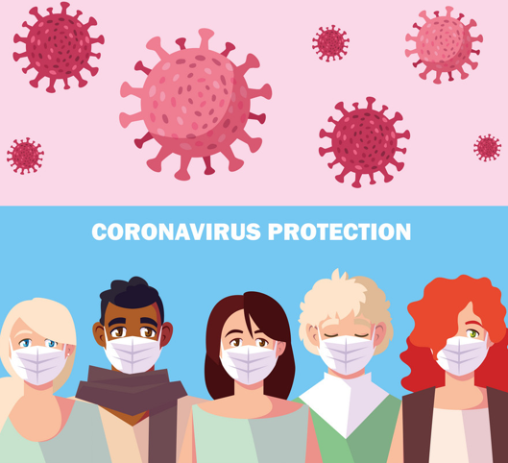
Wearing a Face Mask
Created by John McNally, Student Speech and Language Therapist, under the supervision of Michelle O’Donoghue, SLT, CORU reg 018688

Slide 2
How to use a social story™
Social stories™ are short, simple stories that help people to understand what is going on (Gray 2010).
During this pandemic, there has been a lot of change. Social stories are very helpful to understand some of these changes.
Follow these steps when using this social story:
Read this story before you leave your house to go outside.
When possible read this story in a quiet and calm environment.
Review the story as often as required - some social stories will be reviewed once a day, others just before the situation for which they were written.
As you get used to the new situation and the story no longer seems necessary, you can phase out the story. For example, you can read it only when you are having difficulty understanding ‘why you should wear a face mask’ to refresh your memory.
We hope that you enjoy using this social story.
Reference: Gray, C. (2010) The New Social Story™ Book, Future Horizons: Texas

Slide 3
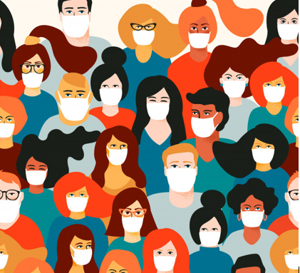
This is a story about why it may be a good idea to wear face masks to protect us from the coronavirus…

Slide 4
What is a face mask?

Slide 5
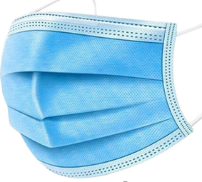
A face mask is made of fabric and it looks like this

Slide 6
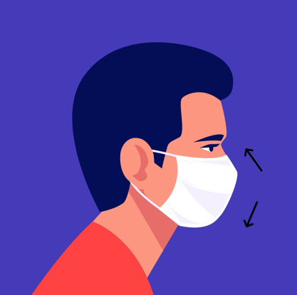
A face mask is something you can wear over your mouth and your nose while you are outside your house

Slide 7
Why do I need to wear a face mask?

Slide 8
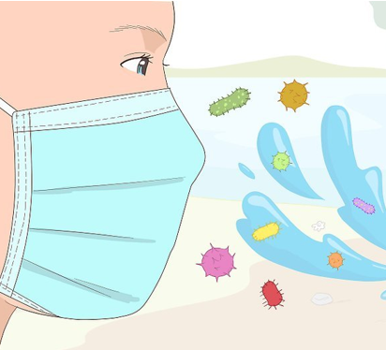
Face masks help to stop us from breathing in the coronavirus

Slide 9
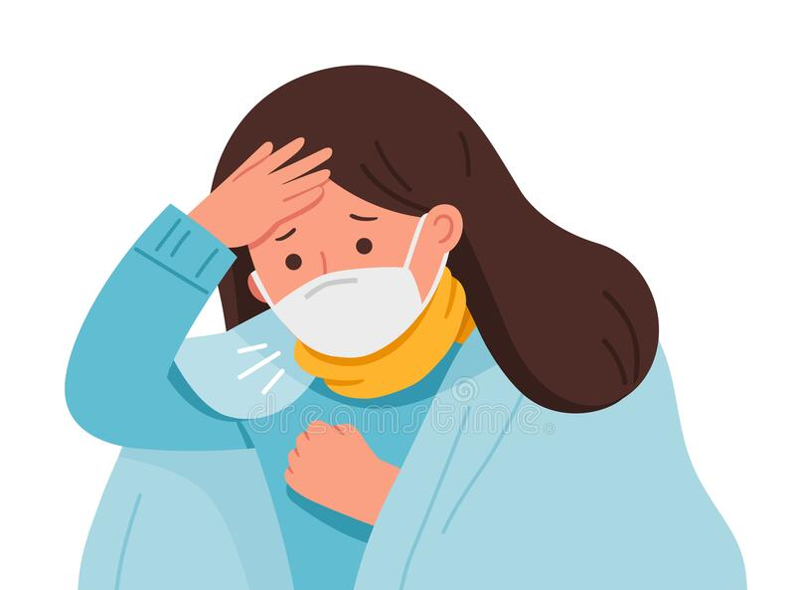
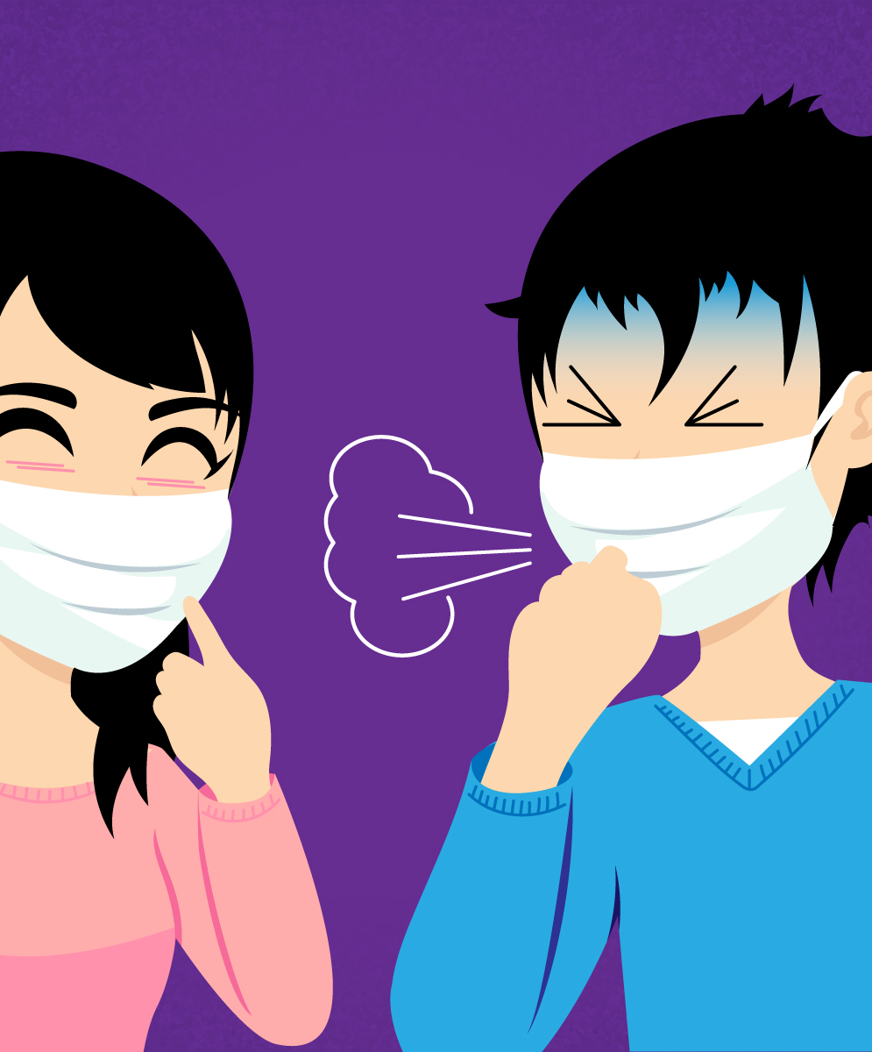
Face masks can help stop us from giving the coronavirus to other people when we cough or sneeze

Slide 10
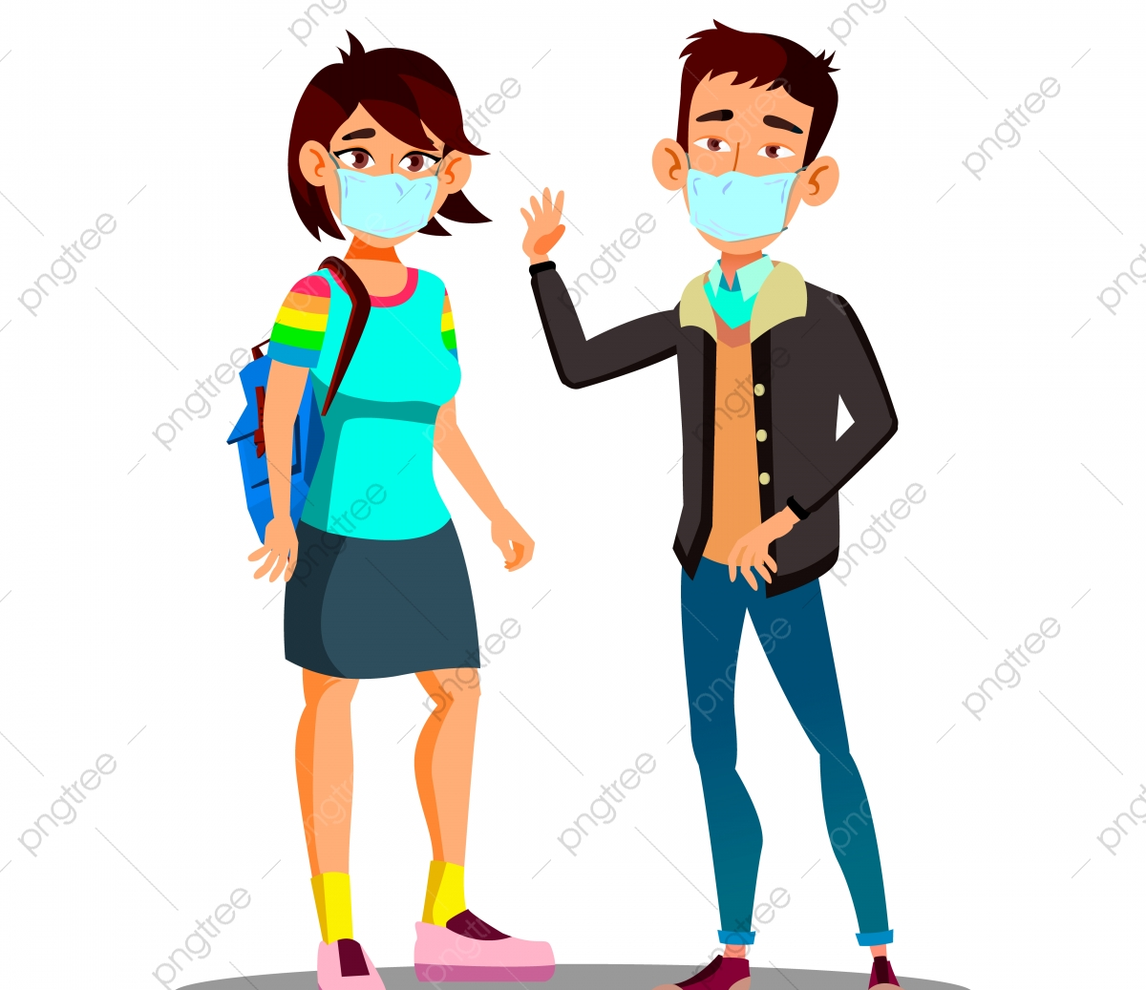
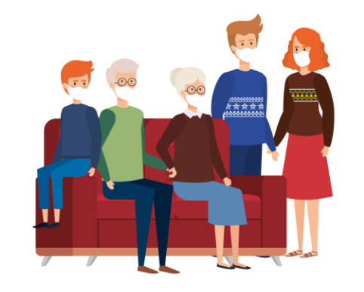
Face masks can protect
Me
My family
My friends
My doctor
My carers

Slide 11
When can I wear a face mask?

Slide 12
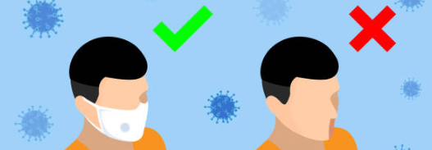
If you want to, you can wear your face mask any time you go outside your house

Slide 13
You can wear your face mask when you are in the park

Slide 14
You can wear your face mask when you go shopping

Slide 15
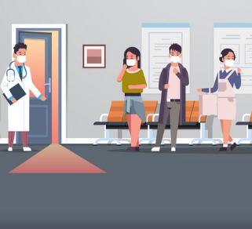
You can wear your face mask when you are at the clinic

Slide 16
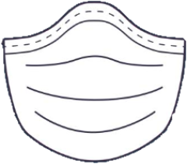
You can wear your face mask when you are at the pharmacy

Slide 17
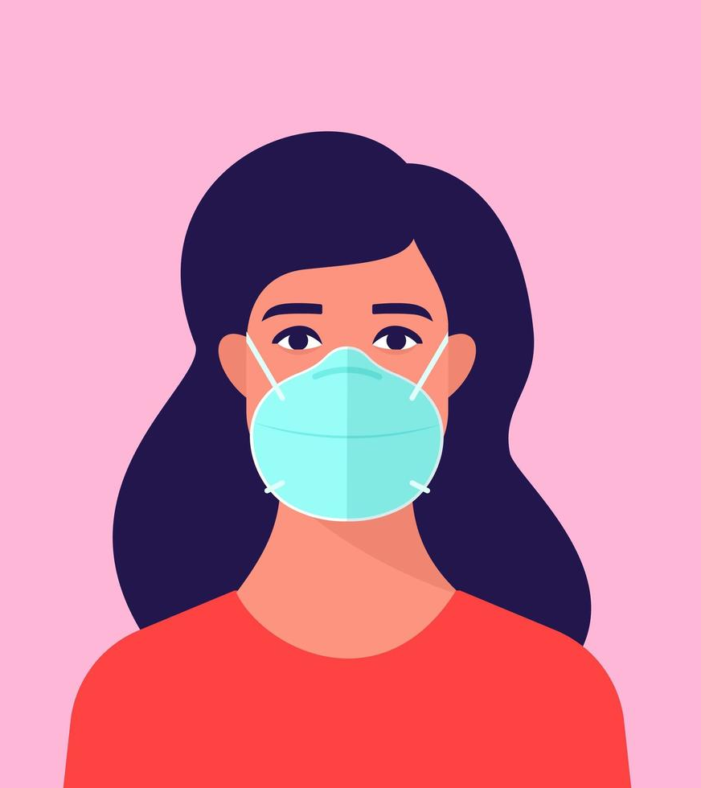
Your face mask might be uncomfortable, but keeping it on when you are outside your house can help to protect you and others

Slide 18
How do I wear a face mask?

Slide 19
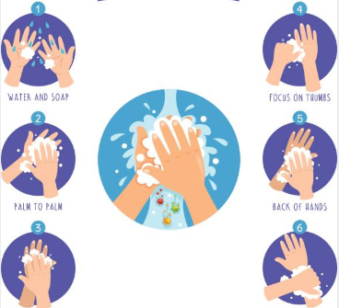
First, clean your hands with soap…

Slide 20
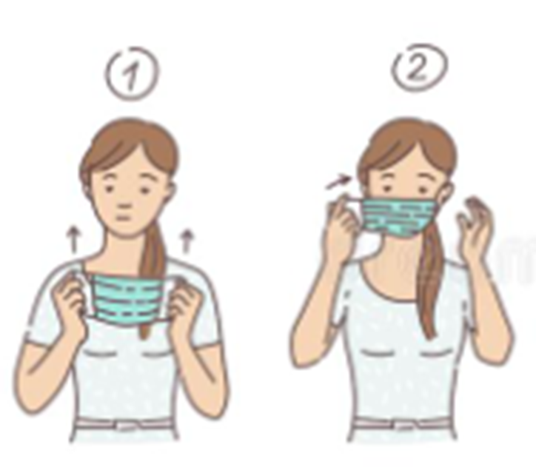
Hold the mask by the ear loops and place them around your ears and the mask over your face

Slide 21
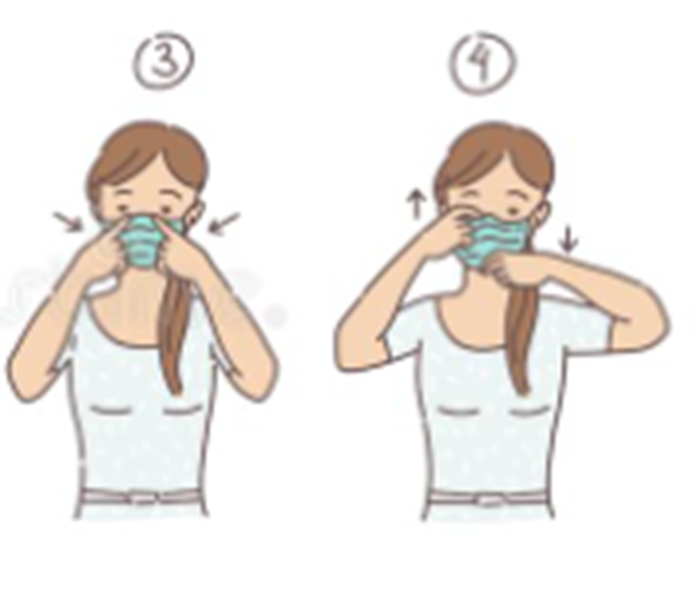
Push the mask tight against your nose and make sure it covers your mouth and nose completely

Slide 22
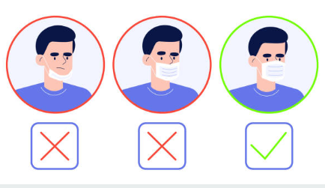
It should cover your face like this…

Slide 23
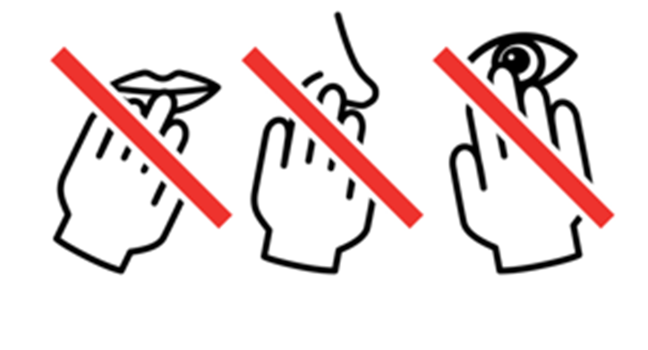
Try not to touch your face when you are wearing your mask

Slide 24
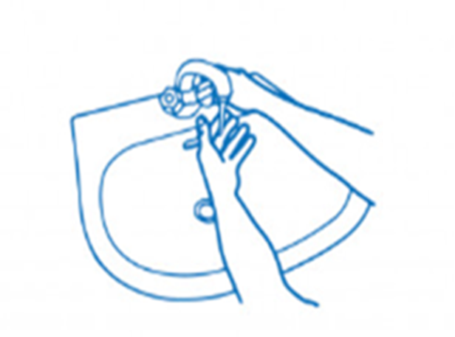
When you are finished with your mask, throw it in the bin and wash your hands immediately

Slide 25
If you have a reusable mask then you can wash it and use it again.

Slide 26
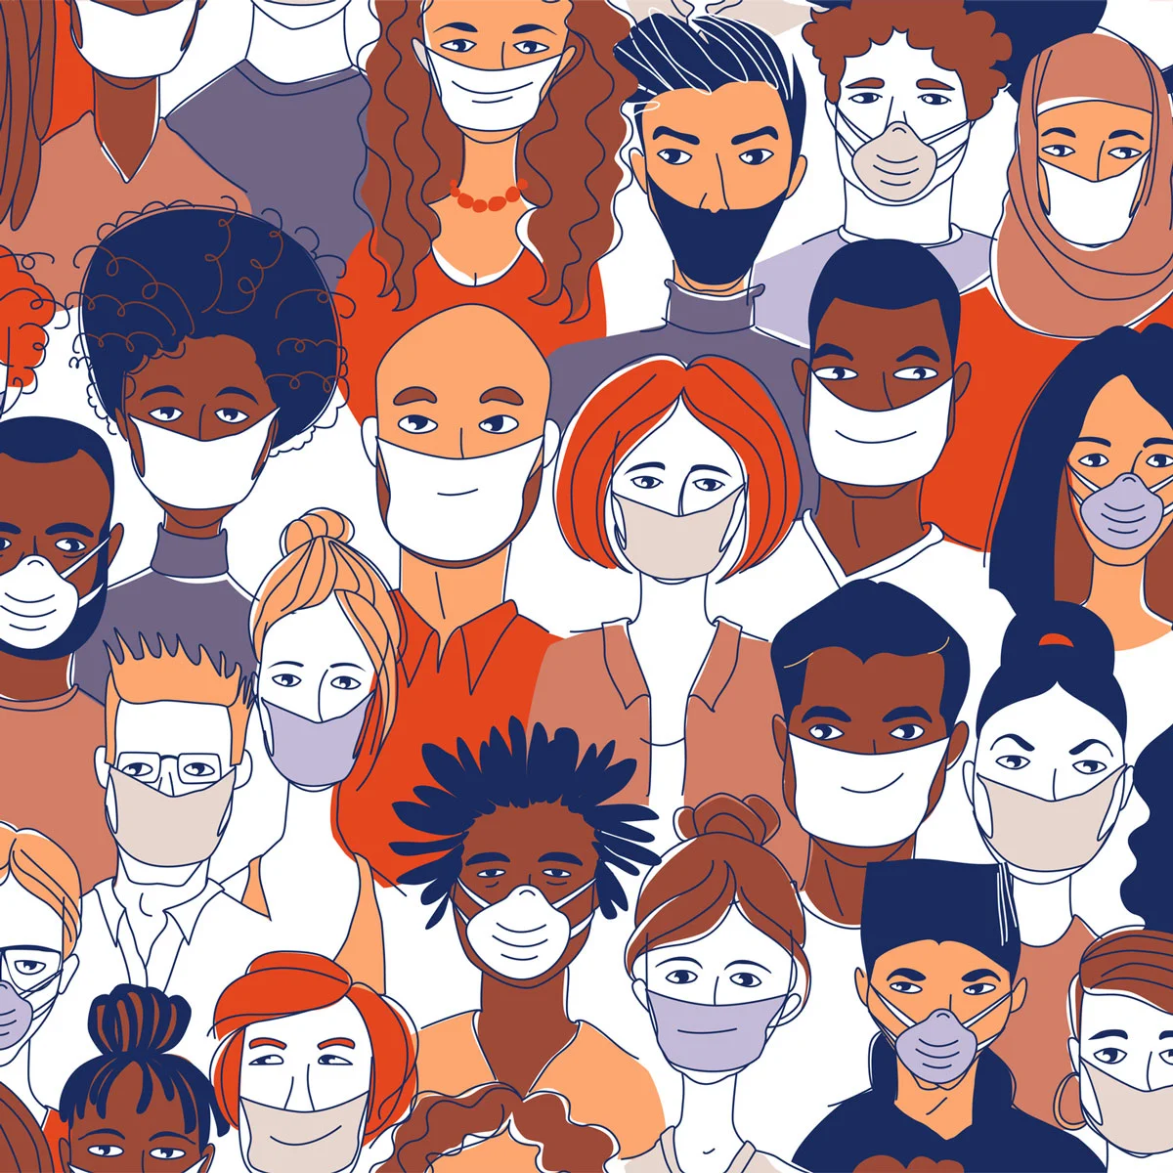
Wearing your face mask can help to protect you and the people around you

Slide 27
References Image page 1: www.vectorstock.com/30150720 Image page 2: https://www.dreamstime.com/coronavirus-pandemic-ncov-vector-seamless-pattern-people-white-medical-face-mask-coronavirus-pandemic-ncov-vector-seamless-image175521504 Image page 3, 6, 11, 18: https://international-adviser.com/wp-content/uploads/sites/3/2020/03/Four-question-marks-blue-background.jpg Image page 4: https://www.go4worldbusiness.com/member/view/2852672/wit-xiantao-tongda-non-woven-products-co-ltd-.html Image page 5: https://www.vecteezy.com/vector-art/952526-man-wearing-disposable-medical-face-mask Image page 7: https://www.bigstockphoto.com/es/image-362022973/stock-vector-crowd-of-infected-and-healthy-people-outside-during-corona-virus-outbreak-men-and-women-protecting Image page 8: http://tyttrungchanh.medinet.gov.vn/chuyen-muc/deo-khau-trang-dung-cach-cmobile9480-25130.aspx Image page 9: https://www.dreamstime.com/stock-illustration-mers-cov-protection-infographic-illustration-image55701731 Image page 10: a: https://pngtree.com/freepng/asian-teen-girl-boy-wearing-a-face-mask-in-the-city-coughing-vector-isolated-cartoon-illustration_5163323.html b: https://es.123rf.com/imagenes-de-archivo/pentagrama.html?alttext=1&orderby=2&sti=m0mlbi63d6sqsqv4to| c: https://www.vectorstock.com/royalty-free-vectors/grandmother-ill-medicine-vectors Image page 12: https://www.istockphoto.com/ie/vector/stop-the-infection-you-need-to-wear-a-medical-mask-a-man-in-a-medical-mask-and-gm1208444346-349303341 Image page 13: https://es.123rf.com/clipart-vector/cartoon_park_playground.html?alttext=1&orderby=2&sti=o3bkp7k8wxvdg0071t|&mediapopup=144983790 Image page 14: https://www.alamy.com/Image ID: 2BER49Y Image page 15: https://www.vectorstock.com/royalty-free-vector/asian-patients-in-masks-visiting-doctor-vector-29661504 Image page 16: https://www.change.org/p/drugs-controller-department-pharmacy-for-pharmacists-only-allow-registered-pharmacist-to-dispense-medicines/c/756206277 Image page 17: https://www.vecteezy.com/vector-art/952547-woman-wearing-medical-face-mask Image page 19: https://www.istockphoto.com/ie/vector/vector-illustration-of-washing-hands-gm988830140-268098633 Image page 20/21: www.google.com/images Image page 22: https://twitter.com/UnivHealthSys/status/1248362577433894912 Image page 23: https://www.dreamstime.com/set-do-not-touch-your-face-icon-simple-black-white-drawing-hand-touching-mouth-nose-eye-crossed-red-line-can-be-set-image176825549 Image page 24: a: www.google.com/images b: www.google.com/images Image page 25: https://www.istockphoto.com/ie/illustrations/quarantine-drawing?mediatype=illustration&phrase=quarantine%20drawing&sort=mostpopular

