Slide 1
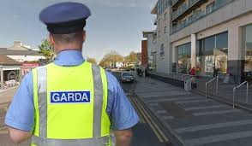
Talking to the Gardaí:
Advice during COVID-19
Created by Lora-Jane Gillen, Student Speech and Language Therapist, under the supervision of Michelle O’Donoghue, SLT, CORU reg 018688

Slide 2
How to use this social story ™
Social stories™ are short, simple stories that help people to understand what is going on (Gray 2010).
During this pandemic, there has been a lot of change. Social stories are very helpful to understand some of these changes.
Follow these steps when using this social story:
Read this story to your child before you leave your house to exercise or go to the shops.
When possible read this story to your child in a quiet and calm environment.
Tell your child what you will do, e.g. “This story is about talking to the Gardai when we are outside. Let's read it together”.
Maintain a positive, reassuring and patient attitude when reviewing the story.
Review the story as often as required - some social stories will be reviewed once a day, others just before the situation for which they were written.
As your child gets used to the new situation and the story no longer seems necessary, you can phase out the story. For example, you can read it only when your child is having difficulty understanding why the Gardai are outside or just occasionally just to refresh their memory.
It is a good idea to personalise this social story. The following are examples of how you can do this:
Page 6 – insert a picture of you and your child exercising
Page 14 – you can insert techniques that help your child when they feel stressed
Change the colour of the background on each page to your child’s favourite colour
You can customize any page in the social story as long as the message remains consistent
We hope that you enjoy using this social story
Reference: Gray, C. (2010) The New Social Story™ Book, Future Horizons: Texas.

Slide 3
The coronavirus is a new germ. Some people call it COVID-19.

Slide 4
Coronavirus can make you very sick.

Slide 5
There are new rules because of the coronavirus.

Slide 6
Rule 1: You can exercise outside. You need to stay within 5km of your home.

Slide 7
2 meters
Rule 2: You need to stay 2 meters away from other people when walking outside

Slide 8
You can go out for important things
Medicine
Doctor appointments
Food

Slide 9
The Gardaí are making sure that people follow the new rules.

Slide 10
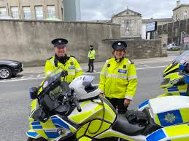
The Gardaí’s job is to keep everyone safe.

Slide 11
A Garda might stop you when you are outside.

Slide 12
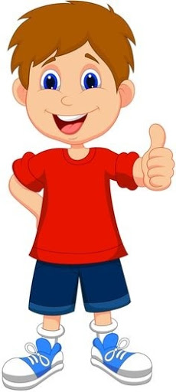
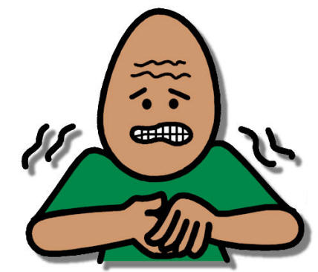
Do not worry.
Everything is ok.
Stay calm

Slide 13
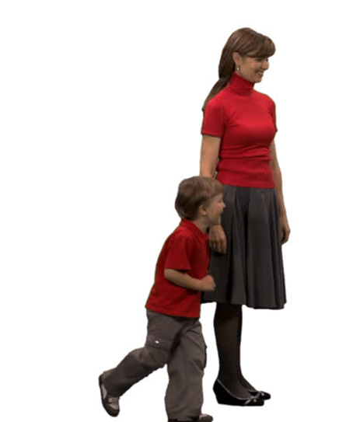
The Garda might ask your Mum or Dad questions.
Hi. Where are you going today?
Hello Garda. We are going out for a walk.

Slide 14
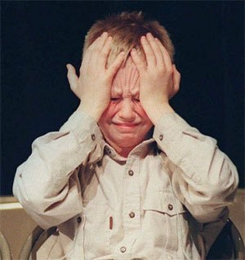
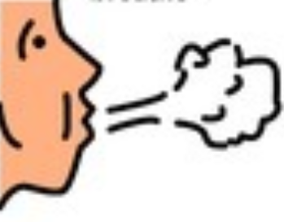
If you feel stressed:
Take 5 deep breaths
Insert what helps your child here

Slide 15
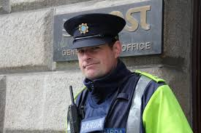
Your Mum or Dad might have a letter to show to the Garda. This letter will help the Garda understand your needs. It is available to print here.

Slide 16
Remember, the Gardaí are making sure that everyone is following these rules to keep us safe and healthy.

