Slide 1
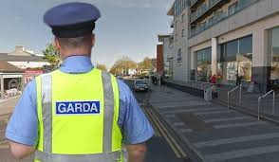
Talking to the Gardaí:
Advice during COVID-19
Created by Lora-Jane Gillen, Student Speech and Language Therapist, under the supervision of Michelle O’Donoghue, SLT, CORU reg 018688

Slide 2
How to use a social story™
Social stories™ are short, simple stories that help people to understand what is going on (Gray 2010).
During this pandemic, there has been a lot of change. Social stories are very helpful to understand some of these changes.
Follow these steps when using this social story:
Read this story before you leave your house to go outside.
When possible read this story in a quiet and calm environment.
Review the story as often as required - some social stories will be reviewed once a day, others just before the situation for which they were written.
As you get used to the new situation and the story no longer seems necessary, you can phase out the story. For example, you can read it only when you are having difficulty talking to a Garda when you go outside
We hope that you enjoy using this social story.
Reference: Gray, C. (2010) The New Social Story™ Book, Future Horizons: Texas

Slide 3
The coronavirus is a new type of virus or illness. It can make you very sick.
The coronavirus is also called COVID-19.

Slide 4
There are new rules to help stop the spread of the coronavirus.

Slide 5
Rule 1: You can exercise outside. You need to stay within 5km of your home

Slide 6
Rule 2: You need to stay 2 metres away from other people when walking outside

Slide 7
You can leave your house to buy important items such as food and medicine. You can go to doctor appointments.
It is ok if these places are more than 2km from your home.

Slide 8
The Gardaí are making sure that people follow the new rules.

Slide 9
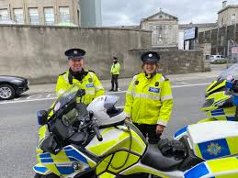
The Gardaí’s job is to keep everyone safe.

Slide 10
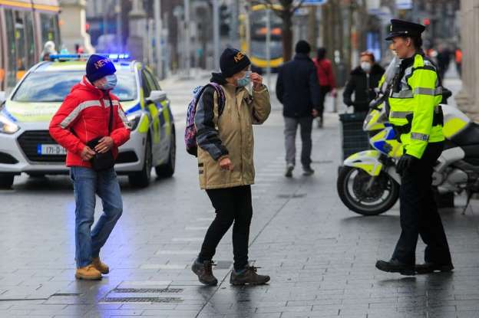
When you are outside, a Garda might stop you and ask you questions.
You are not in trouble.
You do not need to worry.

Slide 11
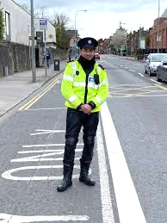
The Garda might ask you where you live. The Garda might ask you where you are going. Answer the Garda’s questions.

Slide 12
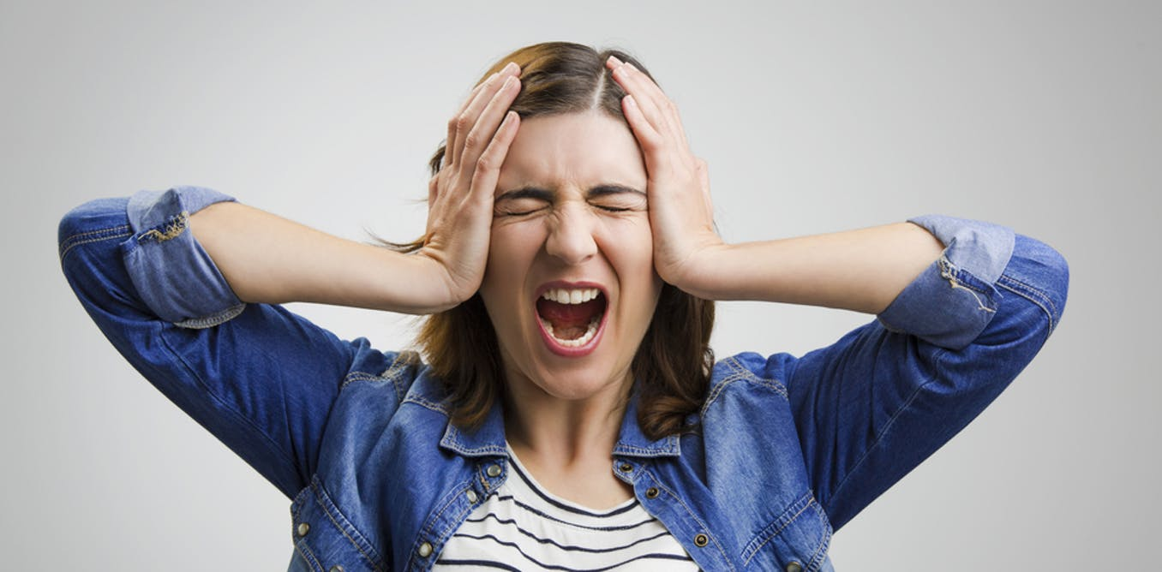
If you feel stressed, tell the Garda what he or she can do to help you.

Slide 13
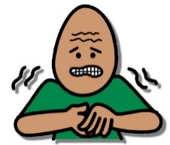
Fill out this card. You can show it to the Garda.
My Name is | THIS IS WHAT MY BEHAVIOUR LOOKS LIKE WHEN I AM STRESSED
I LIVE at
Emergency contact person (name and contact details)
my Diagnosis is | THIS CAN HELP TO CALM ME DOWN
how i communicate

Slide 14
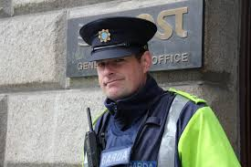
You can show the Garda a letter from AsIAM or your local healthcare provider. This letter will help the Garda understand your needs. It is available to print here.

Slide 15
Remember, the Gardaí are making sure that everyone is following these rules to keep us safe and healthy.

